Slide 1
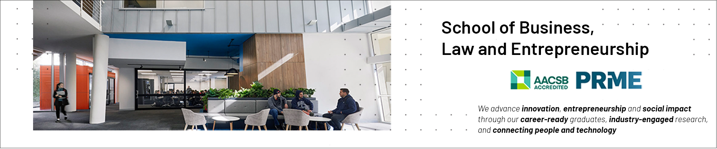

Data Ethics: Artificial Intelligence and the AI Ethics Debate.
School of Business, Law and Entrepreneurship
Online Learning Materiel

Slide 2

This session’s roadmap.
What we will be covering
Artificial Intelligence (AI), Machine Learning (ML) & Common Sense Reasoning
The Trolley Problem & The Moral Machine
Steps and principles to follow for data & AI ethics
The Data Ethics Canvas

Slide 3
Machine Learning (ML).
Machine learning is ‘‘any methodology and set of techniques that can employ data to come up with novel patterns and knowledge and generate models that can be used for effective predictions about the data’’ (Van Otterlo, 2013).
The use of data and algorithms to imitate the way that humans learn, gradually improving its accuracy.
Common examples:
Speech recognition
Computer vision
Recommendation engines
Automated stock exchange trading
Notes:
Van Otterlo M (2013) A machine learning view on profiling. In: Hildebrandt M and de Vries K (eds) Privacy, Due Process and the Computational Turn-Philosophers of Law Meet Philosophers of Technology. Abingdon: Routledge, pp. 41–64.

Slide 4
Machine Learning (ML) / Common-sense reasoning.
Common-sense reasoning is a field of artificial intelligence that aims to help computers understand and interact with people more naturally by finding ways to collect these assumptions and teach them to computers.
Problem 1: Computers do not always have the background of unspoken assumptions.
Problem 2: Technology does not share these assumptions.
Problem 3: No deep meaning.

Slide 5
Artificial Intelligence (AI).
Poorly understood
Any human-like intelligence exhibited by a computer, robot, or other machine (IBM)
Alan Turing (father of AI) speculated in 1950 about “thinking machines” that could reason at the level of a human being.
The “Turing Test” specifies that computers need to complete reasoning puzzles as well as humans in order to be considered “thinking” in an autonomous manner.
AI makes it possible for machines to learn from experience, adjust to new inputs and perform human-like tasks.
Trust is an issue when it comes to AI.

Slide 6
The Crux of the data and AI ethics debate.
“Surveillance is the business model of the Internet” (Schneier 2015).
We have lost ownership of our data, arguably, we have lost control of our data.
These systems know more about us than we know ourselves.
Even just observing online behaviour allows insights into our mental states (Burr and Christianini 2019) and manipulation.
Calls to protect “derived data” (Wachter and Mittelstadt 2019).
What will happen to society, politics and daily life when non-conscious but highly intelligent algorithms know us better than we know ourselves? (Yuval Noah Harari, Homo Deus, 2016, p. 462). Great question, Yuval!

Slide 7
The Crux of the data and AI ethics debate.
The digital sphere has widened greatly.
All data collection and storage is now digital, our lives are increasingly digital, most digital data is connected to a single Internet, and there is more and more sensor technology in use that generates data about non-digital aspects of our lives.
AI increases both the possibilities of intelligent data collection and the possibilities for data analysis.
This applies to blanket surveillance of whole populations as well as to classic targeted surveillance.
Our data is traded between agents, usually for a fee.

Slide 8
Data Ethics: Real-time considerations.
In considering ethical matters, we must consider both current and future uses of data (Hand 2018).
In the past, most analyses were based on static collections of data accumulated through painstaking manual measurement procedures.
Increasingly, however, automatic measurement procedures mean not only that massive data sets are painlessly and cheaply accumulating but also that the measurement is ongoing.
This opens the scope for real-time and online analysis and decision-making—and to recommender systems, autonomous vehicles, in-journey travel route optimization, predictive policing, and so on.

Slide 9
Data Ethics: Ethics Washing & Spinning.
Companies such as Google, Apple, Microsoft, OpenAI, Palantir are increasingly making efforts from an ethical standpoint and are particularly concerned about their ethical reputation in the face of new technological developments in AI and beyond.
But is it enough and is it genuine?
Notes:
Bietti E 2022, From Ethics Washing to Ethics Bashing: A View on Tech Ethics from Within Moral Philosophy, Harvard Law School, viewed 9/3/2022, <https://dl.acm.org/doi/pdf/10.1145/3351095.3372860>.

Slide 10
Data Ethics: Ethics Washing & Spinning /2.
The word 'ethics' is under siege in technology policy circles.
Weaponised in support of deregulation, self-regulation or hands-off governance, “ethics” is increasingly identified with technology companies’ self-regulatory efforts and with shallow appearances of ethical behaviour.
So-called “ethics washing” by tech companies is on the rise, prompting criticism and scrutiny from scholars and the tech community at large (Bietti 2020).
“Ethics bashing” to refer to how tech companies attempts to self-regulate ethics get trivialised so that ethics comes to be seen as something as simple as having an ethics board or a plan for self-governance rather than an intrinsically valuable mode of seeking knowledge.
Notes:
Bietti E 2022, From Ethics Washing to Ethics Bashing: A View on Tech Ethics from Within Moral Philosophy, Harvard Law School, viewed 9/3/2022, <https://dl.acm.org/doi/pdf/10.1145/3351095.3372860>.

Slide 11
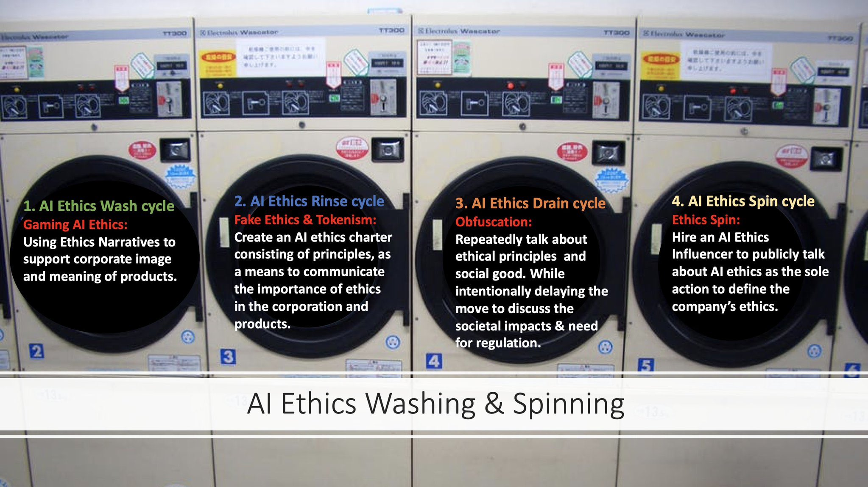
Ethical ‘Washing’
Ethical AI and ethics boards are also tarnished by ‘ethics washing’, where they are a seen only as a means to protect the company reputation when decisions are held under an ethical microscope, rather than hold any real power (Bietti 2020, p. 215).

Slide 12
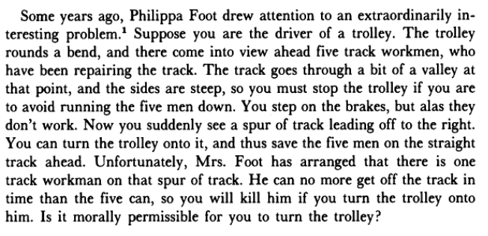
The Trolley Problem.
See Phillipa Foot (1967) & Judith Thompson (1976; 1985)
Notes:
Thompson, J 1985, The Trolley Problem, The Yale Law Journal, 94(6), pp. 1395-1415.

Slide 13
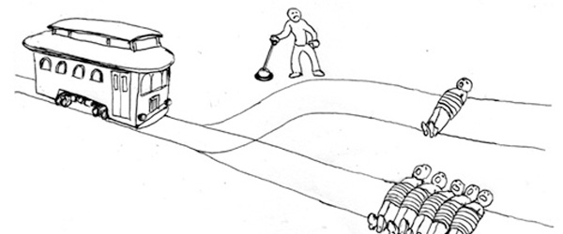
The Trolley Problem /2.
See Phillipa Foot (1967) & Judith Thompson (1976; 1985)
.B.
.A.

Slide 14
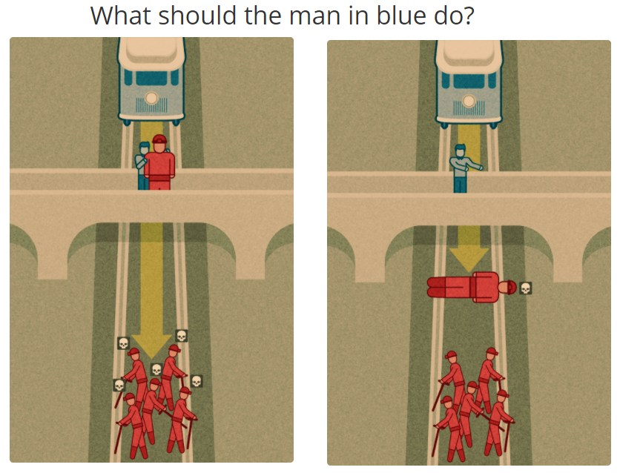
The Trolley Problem /3.
See Phillipa Foot (1967) & Judith Thompson (1976; 1985)

Slide 15

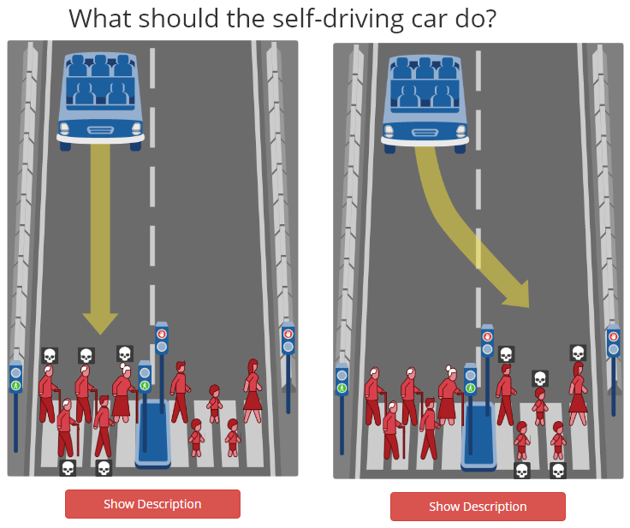
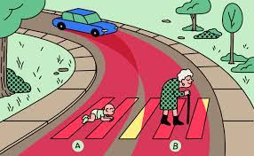

The Trolley Problem /4.
https://www.moralmachine.net/

Slide 16
6 Pragmatic steps of data ethics for ICT Professionals.
Inform & consent
Privacy & protection
Two-way Transparency
Respect the rules
Privacy by Design (PbD)
Algorithm evaluation & auditing

Slide 17
AI Ethics Principles.
Dept. Industry, science, Energy & Resources
Human, social and environmental wellbeing: Throughout their lifecycle, AI systems should benefit individuals, society and the environment.
Human-centred values: Throughout their lifecycle, AI systems should respect human rights, diversity, and the autonomy of individuals.
Fairness: Throughout their lifecycle, AI systems should be inclusive and accessible, and should not involve or result in unfair discrimination against individuals, communities or groups.
Privacy protection and security: Throughout their lifecycle, AI systems should respect and uphold privacy rights and data protection and ensure the security of data.

Slide 18
AI Ethics Principles / 2.
Dept. Industry, science, Energy & Resources
Reliability and safety: Throughout their lifecycle, AI systems should reliably operate in accordance with their intended purpose.
Transparency and explainability: There should be transparency and responsible disclosure to ensure people know when they are being significantly impacted by an AI system, and can find out when an AI system is engaging with them.
Contestability: When an AI system significantly impacts a person, community, group or environment, there should be a timely process to allow people to challenge the use or output of the AI system.
Accountability: Those responsible for the different phases of the AI system lifecycle should be identifiable and accountable for the outcomes of the AI systems, and human oversight of AI systems should be enabled.

Slide 19
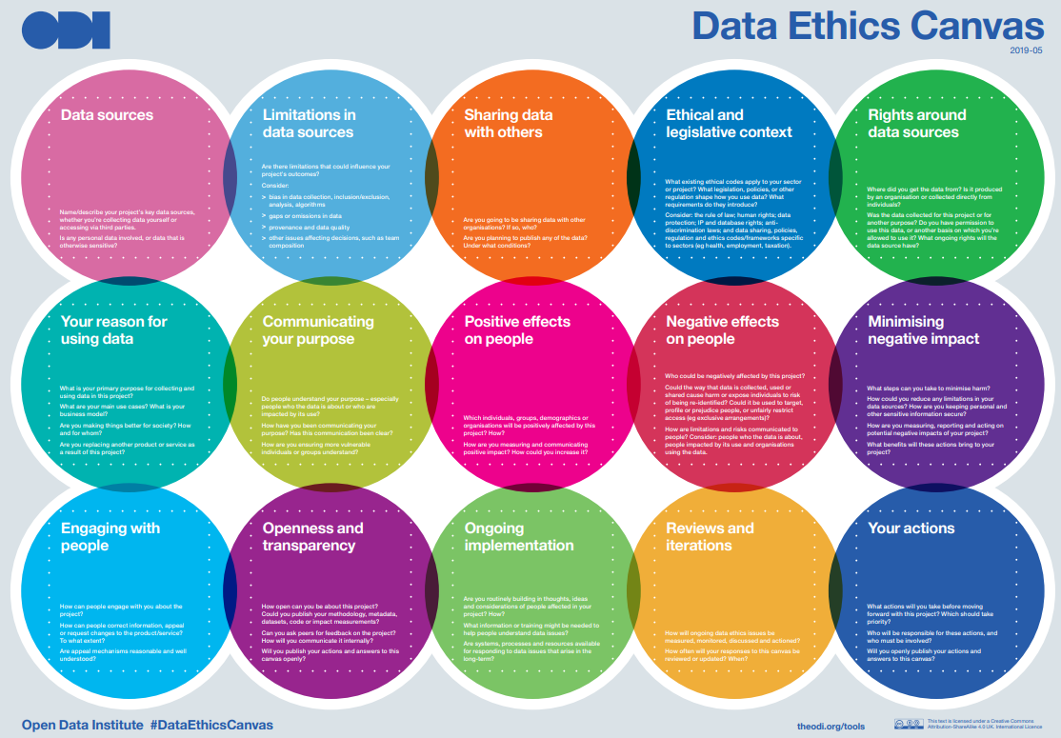
Notes:
Original source The Data Ethics Canvas is based on the Ethics Canvas, a higher-level framework for assessing the ethical implications of any project, developed by the ADAPT Centre for Digital Content Technology. The ADAPT Centre’s Ethics Canvas is itself based on the original Business Model Canvas by Alex Osterwalder.

Slide 20
Have we met our objectives?
Defined data ethics, data and big data
Described applied examples of data ethics for ICT professionals
Explored issues around Artificial Intelligence (AI) and Algorithms
Focused on the Trolley Problem and MIT’s ‘The Moral Machine’
Identified pragmatic steps and principles to follow to help design and manage data and AI ethics
Viewed the Data Ethics Canvas
Identified areas for further exploration in your own time
Left the session more knowledgeable than when arriving

Slide 21


